Slide 1
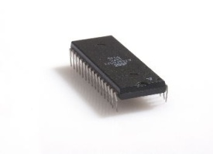
WBS
TYPE
Reg
Mem Ctrl Rd
Mem Ctrl Wr
wr_cnt
wr_cnt_en
WBS
DBG ADDR
Reg
R2
R1
WBM
WBM
New SDRAM Arbiter
WBM
WBM
Img. Manipulation - Memory Read
Mem write back
(Final image)
Addr Conv
Bilinear Intrepolation
Algorithm –Addr Calc
Param Reg
256 words
RAM
wr_rd_bank
R1 – Ram 8→16 bits
R2 – Ram 16→8 bits
WBS
IS42S16400 SDRAM
SDRAM Controller
WBM – Wishbone Master
WBS – Wishbone Slave
Notes:
Mem Ctrl Wr - קונטרולר

